Slide 1
Module 1 : Introduction to Data Science
Kaustubh Kulkarni

Slide 2
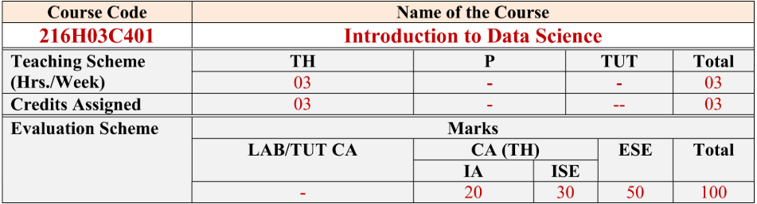

Slide 3
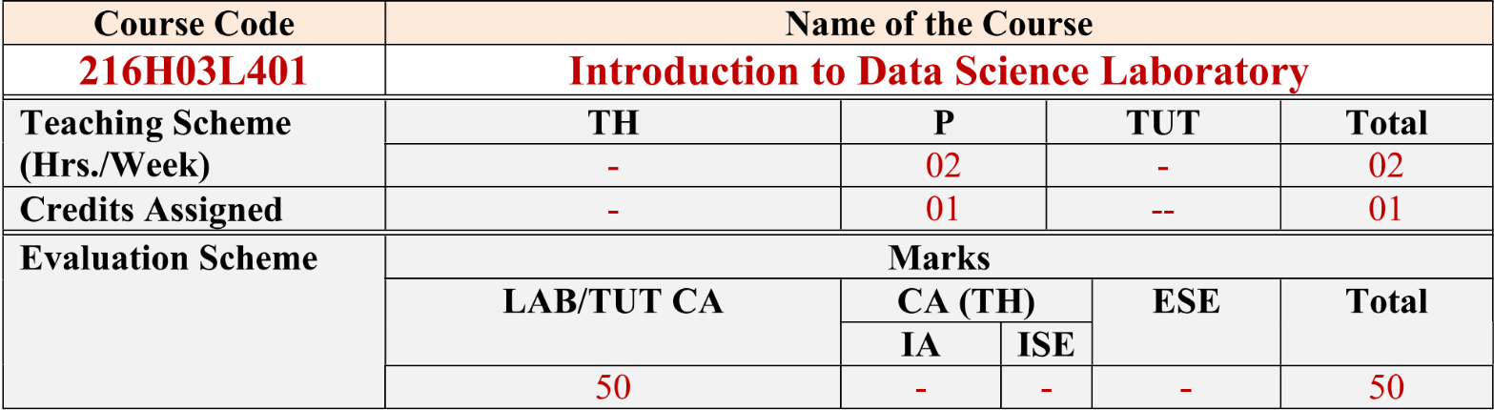

Slide 4
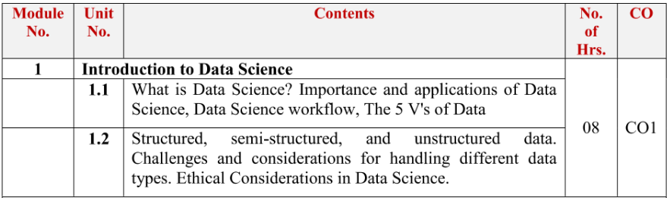

Slide 5
What is Data Science?
Data science is the field of study that extracts relevant insights and develops strategy from data for business and industry.
Combining tools, methods, and technology, data scientists ask and answer questions like
what happened
why did it happen
what will happen, and
how can the results be extrapolated and used for planning and decision-making

Slide 6
Datafication

Slide 7
Taking all aspects of life and turning them into data
We quantify friendships with “likes”
It’s the way everything we do, online or otherwise, ends up recorded for later examination in someone’s data storage units.
Or maybe multiple storage units, and maybe also for sale.

Slide 8
Social Media Interactions
Imagine you browse through a few websites looking for sneakers.
Minutes later, your Instagram feed is flooded with ads for shoes.
Liking some posts about fitness may result in an influx of gym membership or supplement ads.

Slide 9
Ever wondered how that happens?
Your smartphone, apps, and websites aren't just tools
They are constantly collecting data about you
Your location
Your search history
The time you spend on certain apps
Even the speed at which you type or scroll

Slide 10
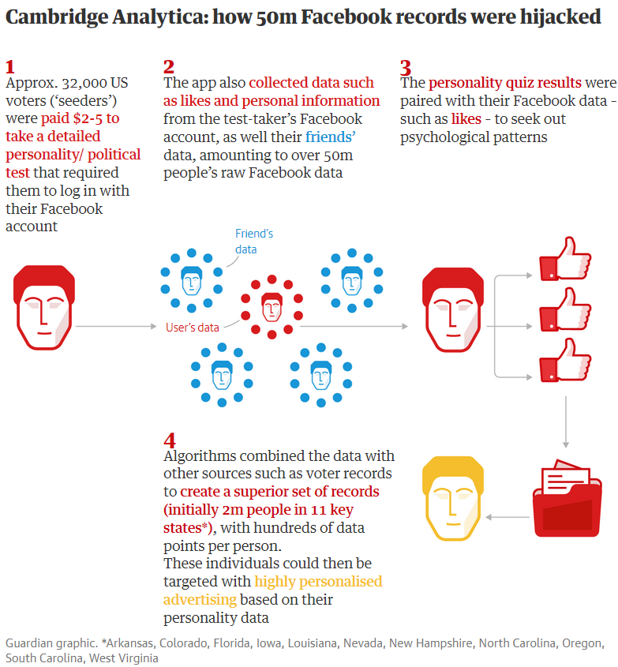

Slide 11
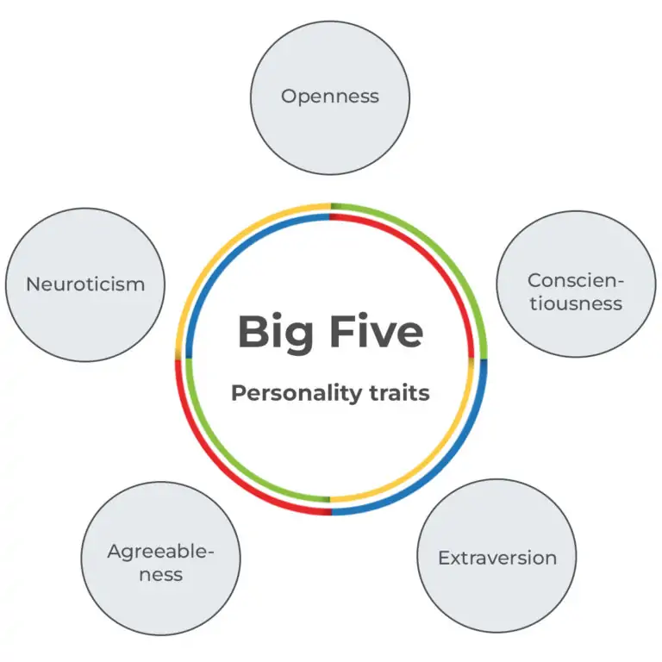

Slide 12
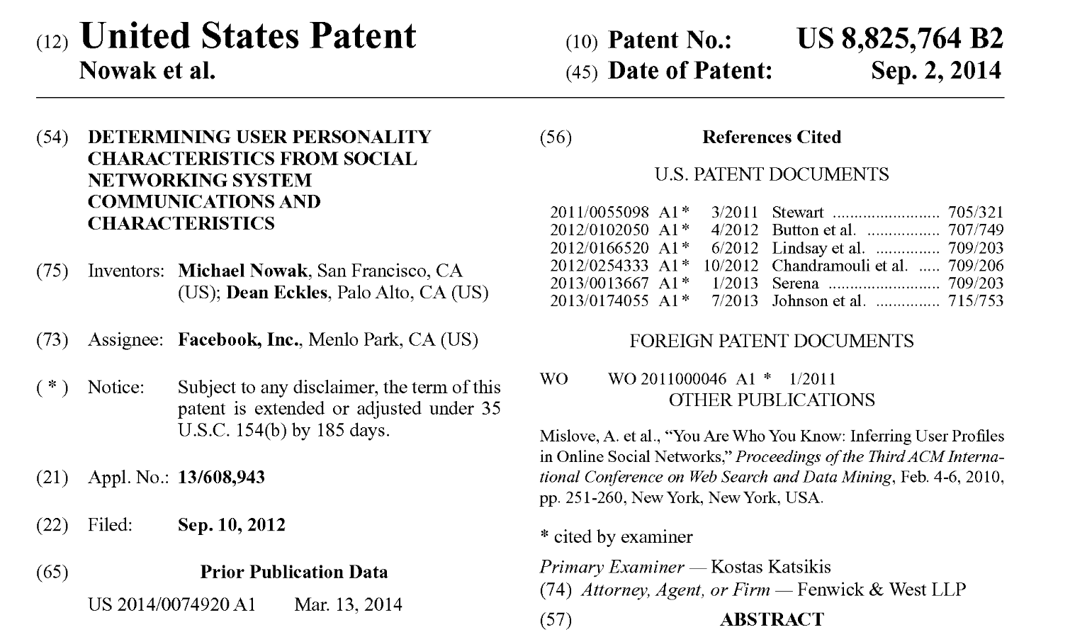

Slide 13
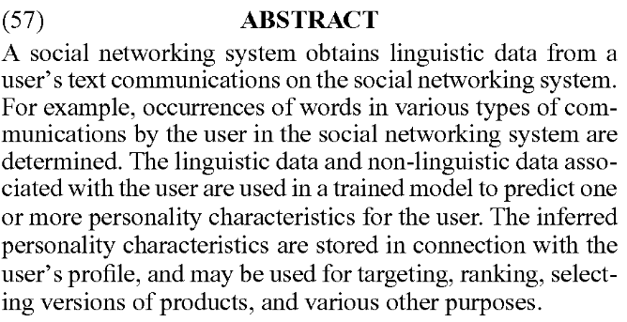

Slide 14

A campaign advert tested by Cambridge Analytica

Slide 15
Online Shopping
E-commerce platforms like Amazon track:
What you search for, even if you don’t buy.
How long you spend on a product page.
The sequence in which you view items.
Purpose: To recommend products and predict future purchases.
Data Use: This data is shared with third-party sellers or used to improve their own-brand products, often competing with the ones you viewed.

Slide 16
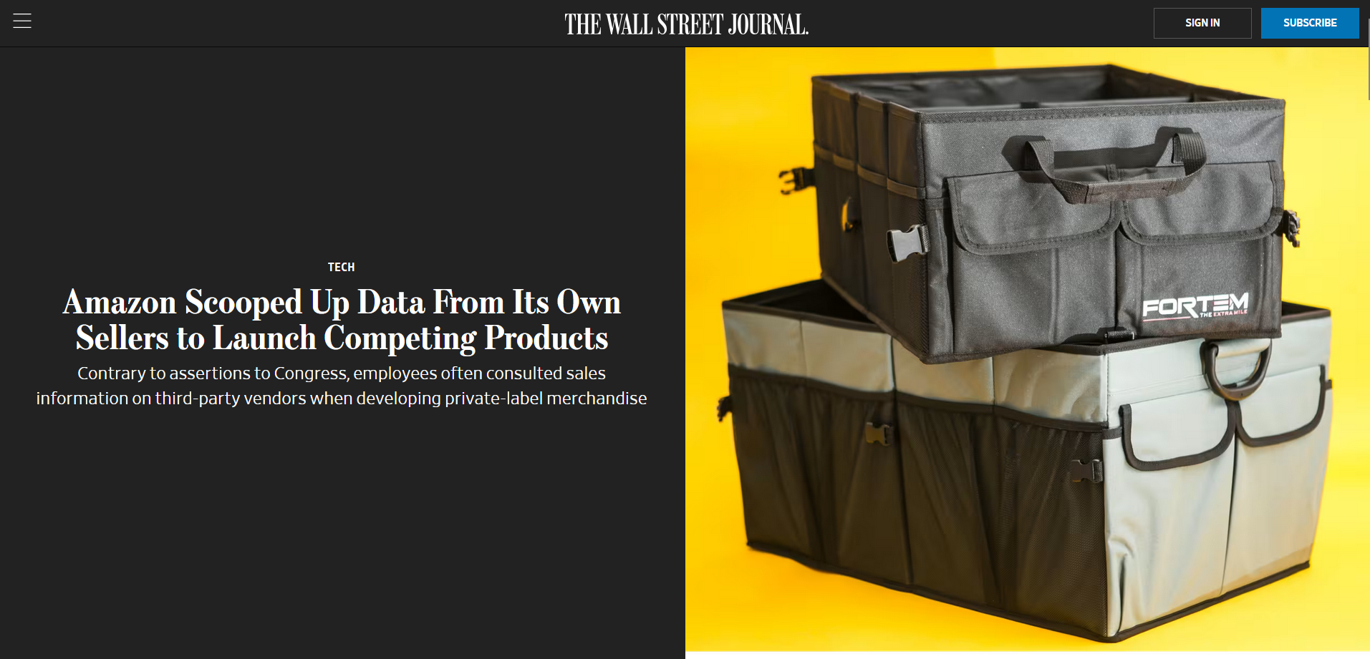

Slide 17
Health and Fitness Apps
Wearables like Fitbits or apps like MyFitnessPal collect data about:
Your exercise routines, heart rate, and calorie intake.
Purpose: To improve health insights and recommend habits.
Data Use: Some of this data has been sold to insurance companies, which might adjust premiums based on your lifestyle data.

Slide 18


Slide 19
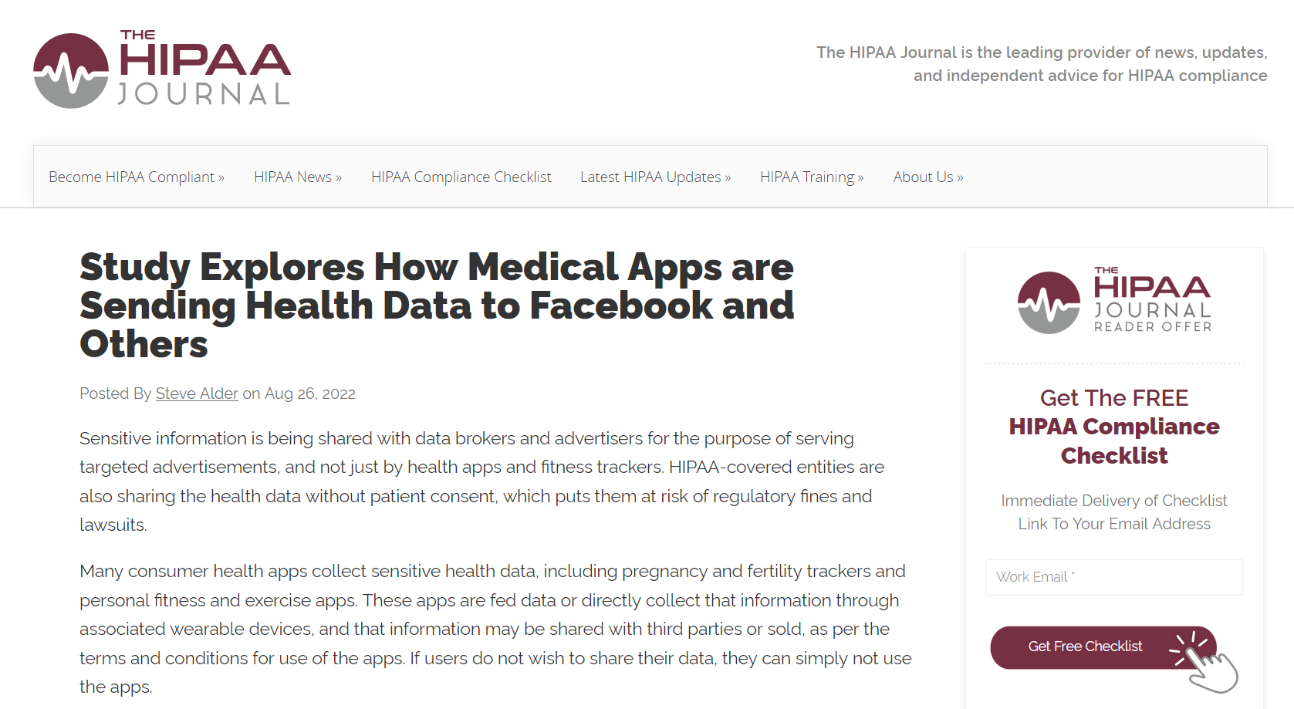

Slide 20
Predictive Behaviour Analysis
Companies now use this data to predict not just what you'll buy next, but also:
Your mental health—based on the words you search and the times of day you’re active.
Your political preferences—based on the articles you read and like.
Whether you're likely to drop out of college—an actual prediction model used by some universities.
Your potential as a future employee—some companies analyze social media to assess your 'fit.'

Slide 21
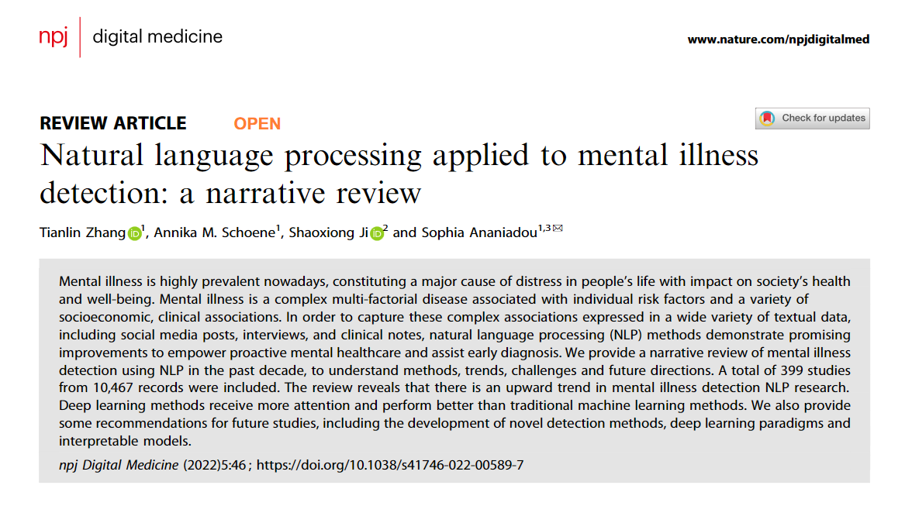

Slide 22
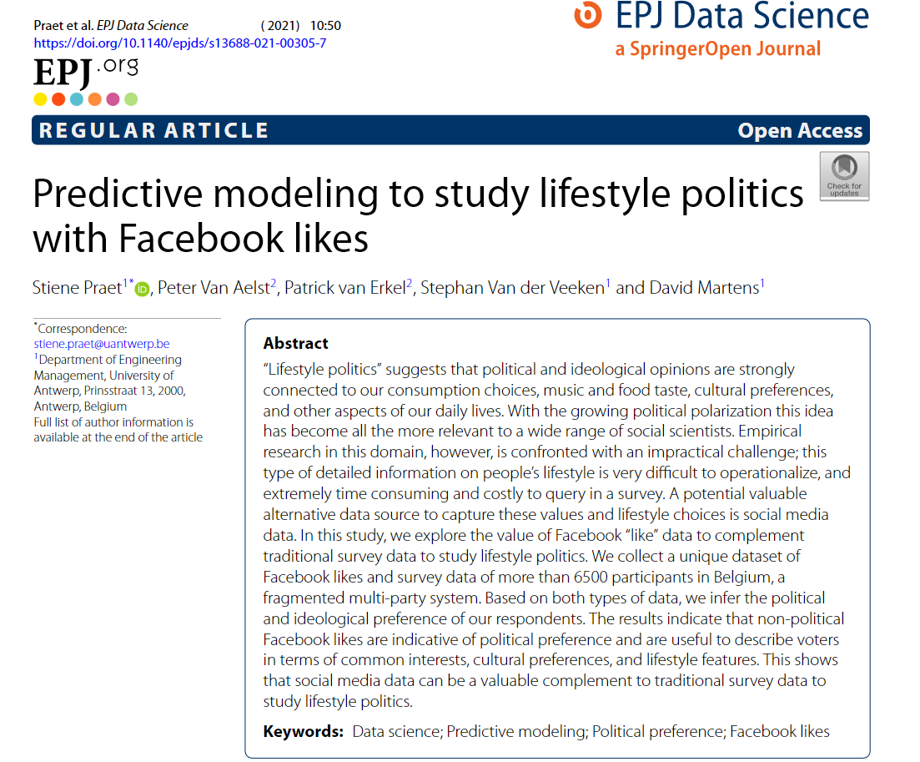

Slide 23
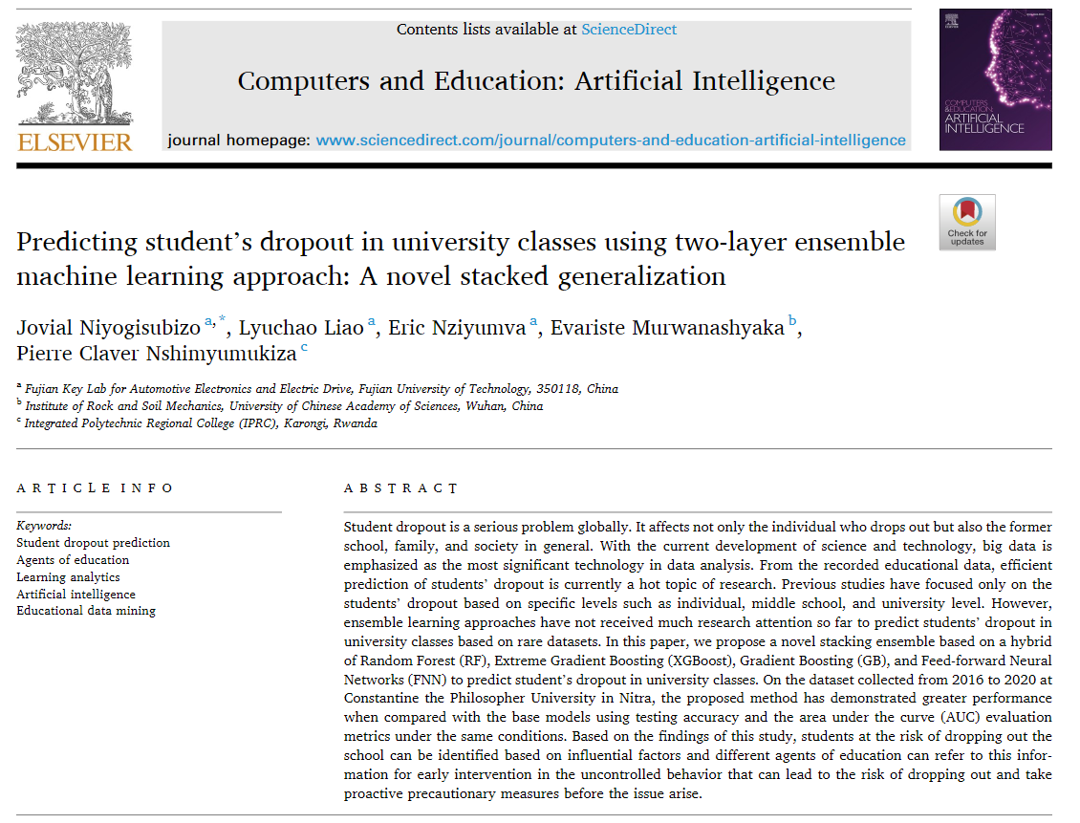

Slide 24
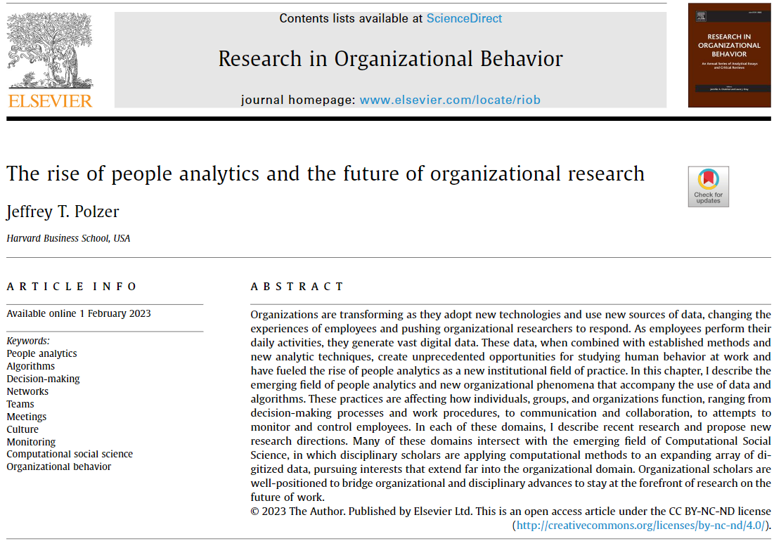

Slide 25
